Slide 1


PHISHING WEBSITE DETECTION by MACHINE LEARNING TECHNIQUES
By-
Piyush Niranjan
Udit Pratap Singh Rajawat
MAULANA AZAD NATIONAL INSTITUTE OF TECHNOLOGY

Slide 2
INTRODUCTION
Phishing is the most commonly used social engineering and cyber attack.
Through such attacks, the phisher targets newbie online users by tricking them into revealing confidential information, with the purpose of using it fraudulently.
In order to avoid getting phished,
users should have awareness of phishing websites.
have a blacklist of phishing websites which requires the knowledge of website being detected as phishing.
detect them in their early appearance, using machine learning algorithms.
The machine learning based K-NN method is proven to be most effective than the other methods.
Even then, online users are still being trapped into revealing sensitive information in phishing websites.

Slide 3
OBJECTIVES
A phishing website is a common social engineering method that mimics
trustful uniform resource locators (URLs) and webpages.
The objective of this project is to train machine learning models on the dataset
created to predict phishing websites.
Both phishing and Safe URLs of websites are gathered to form a dataset and
from them required URL and website content-based features are extracted.
The performance level of each model is measures and compared.

Slide 4
APPROACH
Below mentioned are the steps involved in the completion of this project:
Collect dataset containing phishing and legitimate websites from the open source platforms.
Write a code to extract the required features from the URL database.
Analyze and preprocess the dataset by using EDA techniques.
Divide the dataset into training and testing sets.
Run selected machine learning algorithms like SVM,
Random Forest, Decision Tree and K-NN on the dataset.
Write a code for displaying the evaluation result considering accuracy metrics.
Compare the obtained results for trained models and specify which is better.

Slide 5
DATA COLLECTION
Legitimate URLs are collected from the dataset provided by University of New Brunswick,
https://www.unb.ca/cic/datasets/url-2016.html.
From the collection, 5000 URLs are randomly picked.
Phishing URLs are collected from opensource service called PhishTank . This service provide
a set of phishing URLs in multiple formats like csv, json etc. that gets updated hourly.
Form the obtained collection, 5000 URLs are randomly picked.

Slide 6
FEATURE SELECTION
The following category of features are selected:
Address Bar based Features
Domain based Features
HTML & Javascript based Feature
Address Bar based Features considered are:
Domian of URL | Redirection ‘//’ in URL
IP Address in URL | ‘http/https’ in Domain name
‘@’ Symbol in URL | Using URL Shortening Service
Length of URL | Prefix or Suffix "-" in Domain
Depth of URL

Slide 7
FEATURE SELECTION
Domain based Features considered are:
DNS Record | Age of Domain
Website Traffic | End Period of Domain
HTML and JavaScript based Features considered are:
Iframe Redirection | Disabling Right Click
Status Bar Customization | Website Forwarding
All together 17 features are extracted from the dataset.

Slide 8
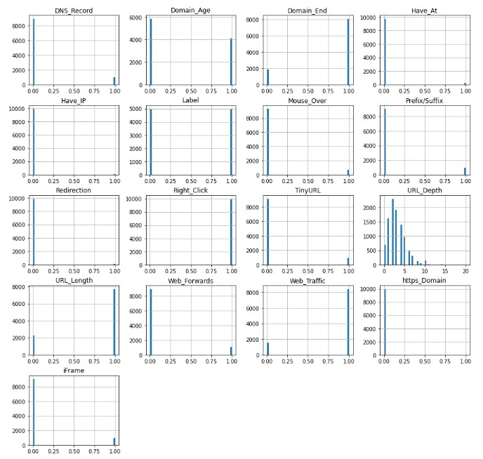
FEATURES DISTRIBUTION

Slide 9
MACHINE LEARNING MODELS
This is a supervised machine learning task. There are two major types of supervised
machine learning problems, called classification and regression.
This data set comes under classification problem, as the input URL is classified as phishing (1)
or legitimate (0).
The machine learning models (classification) considered to train the dataset in this notebook are:
Decision Tree
Random Forest
SVM
K-NN

Slide 10
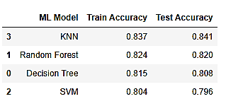
Model Evaluation
The Models are evaluated , and the considered metric is accuracy
Below Figure shows the training and test dataset accuracy by the respective models
For the above it is clear that the K-NN model gives better performance. The model is saved for further usage.

Slide 11
NEXT STEPS
Working on this project is very knowledgeable and worth the effort.
Through this project, one can know a lot about the phishing websites and how
they are differentiated from legitimate ones.
This project can be taken further by creating a browser extensions of developing a GUI.
These should classify the inputted URL to legitimate or phishing with the use of the saved model.

Slide 12
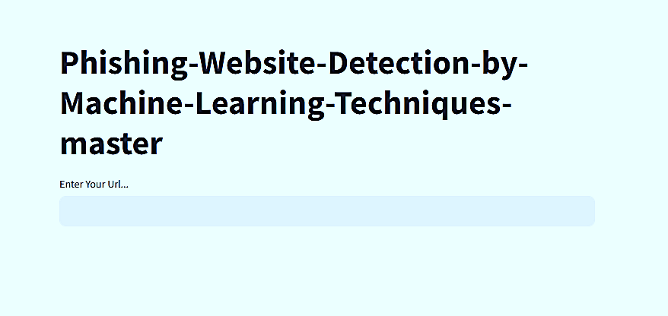
Application Images
Index Screen

Slide 13
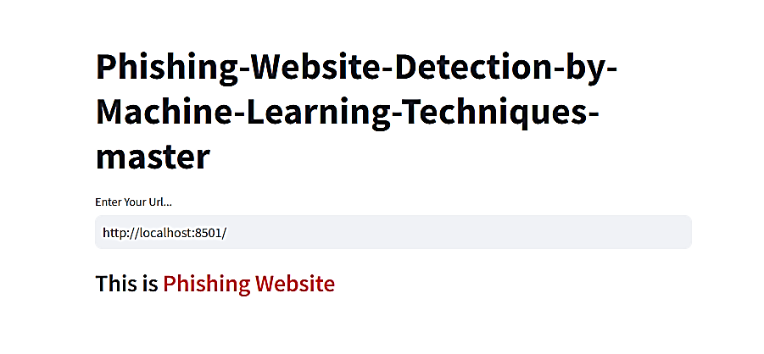
Application Images
Prediction Screen - 01

Slide 14
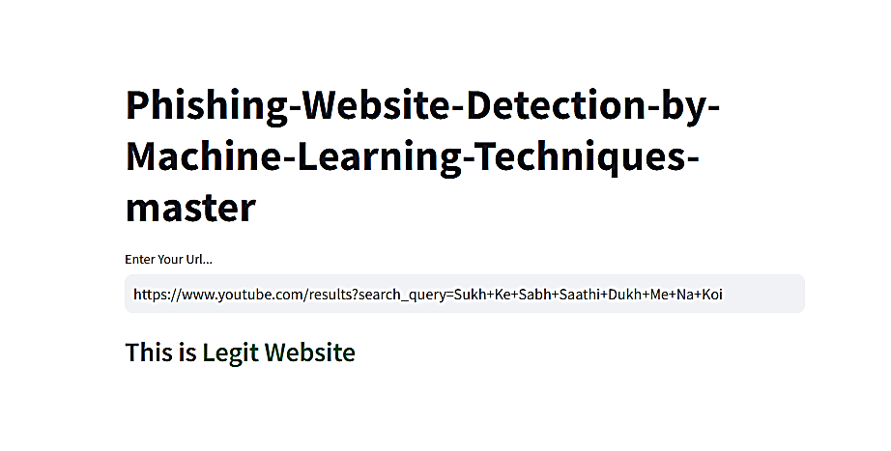
Application Images
Prediction Screen - 02

Slide 15

Thank You…..

